Slide 1

NYC RESTAURANT INSPECTION DATASET
ADTA 5240 FINAL PRESENTATION
Presentation by: Group 6

Slide 2
NYC Restaurant Inspections
Hospitality
Let’s look into the contents of the Presentation:
Data generation & collection
Data preprocessing
Team members
Data
Roles and Responsibilities
Brief about the dataset.
How the data is generated & where is it collected from?
What are the steps performed to clean the data and tools used?
01
02
03
04

Slide 3
NYC Restaurant Inspections
Hospitality
Let’s look into the contents of the Presentation:
Data Visualization
Data interpretation
Data analysis / Queries
Data Storage
Visual representation of data.
Findings in the data
What kind of data is it and how do we store it?
What are the insights and patterns of data to help restaurants business?
05
06
07
08

Slide 4



Team members
Prathyusha Jampala
Responsible for Data Handling
Jadyn McCullough
Responsible for Data interpretation
Destinae Dennis
Responsible for Data Storage

Slide 5

DATA
NYC Restaurants Inspection dataset.
300,000 rows
13 columns including: [ camis ,DBA, Boro, Zipcode, Cuisine description, Inspection date, Action, violation code, violation description, Critical flag, score,grade, inspection type].
Presence of null values, and unnecessary attributes.

Slide 6

DATA GENERATION & COLLECTION
Data Source: Tidy Tuesday
NYC open data: DOHMH New York City Restaurant Inspection Results.
Health Department’s Restaurant Grading website
Repeated restaurants when more than one violation
Contains missing,illogical values while data entry or transfer

Slide 7
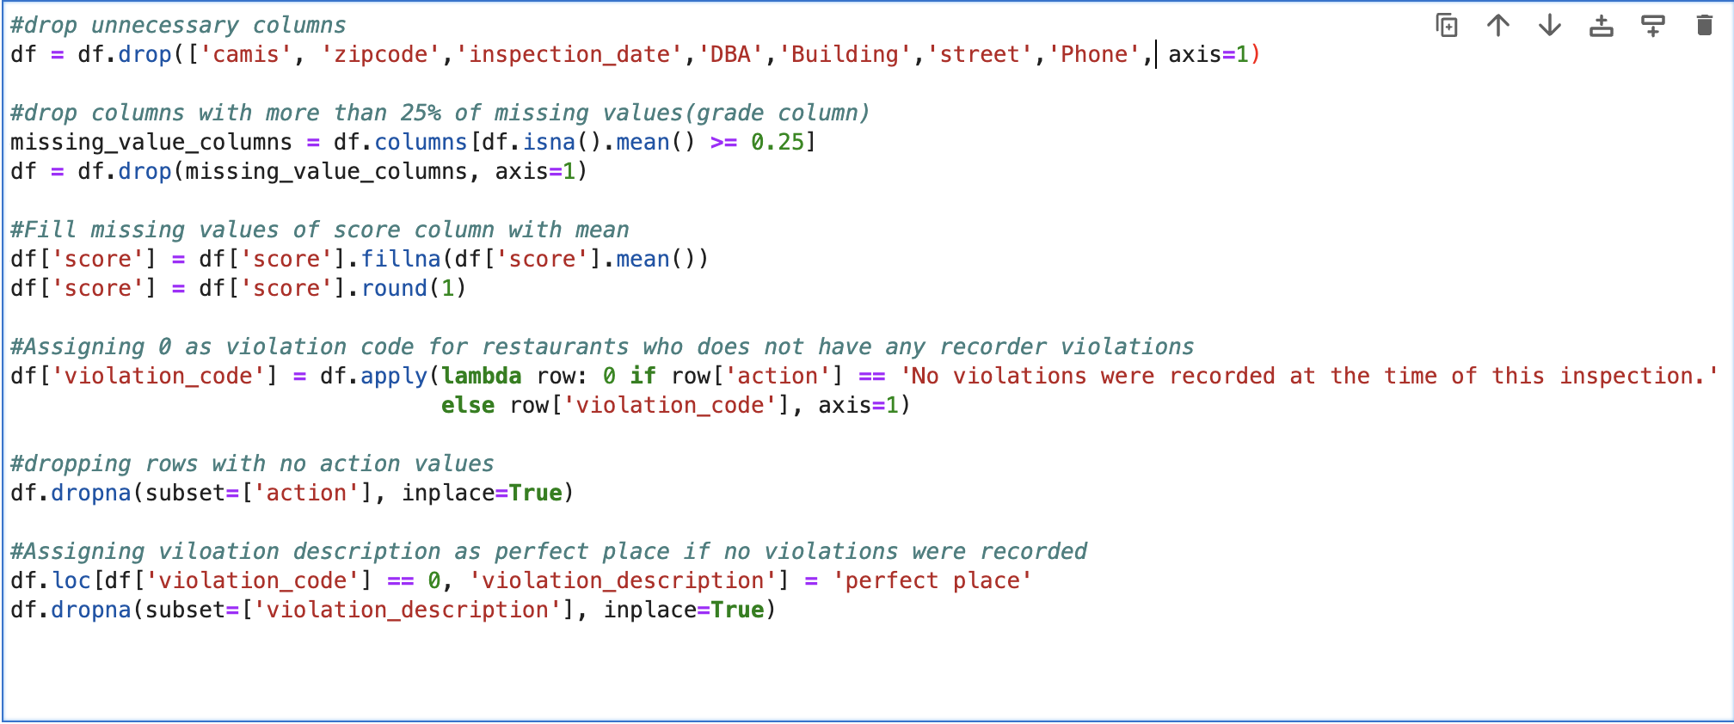
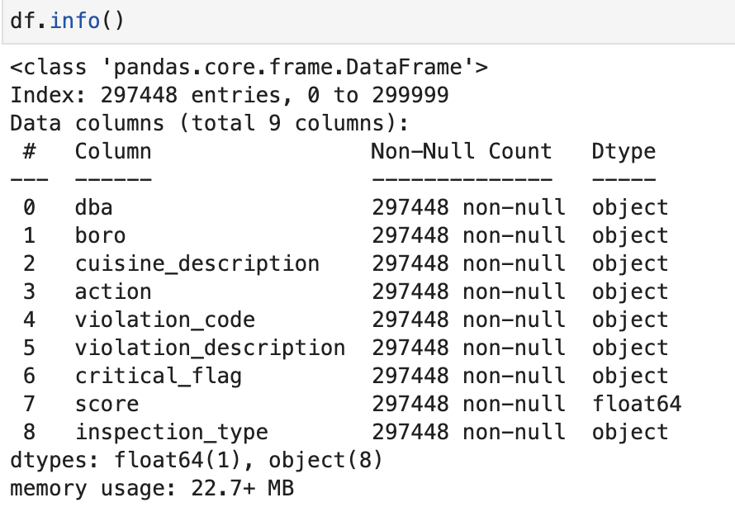
DATA PROCESSING

Slide 8
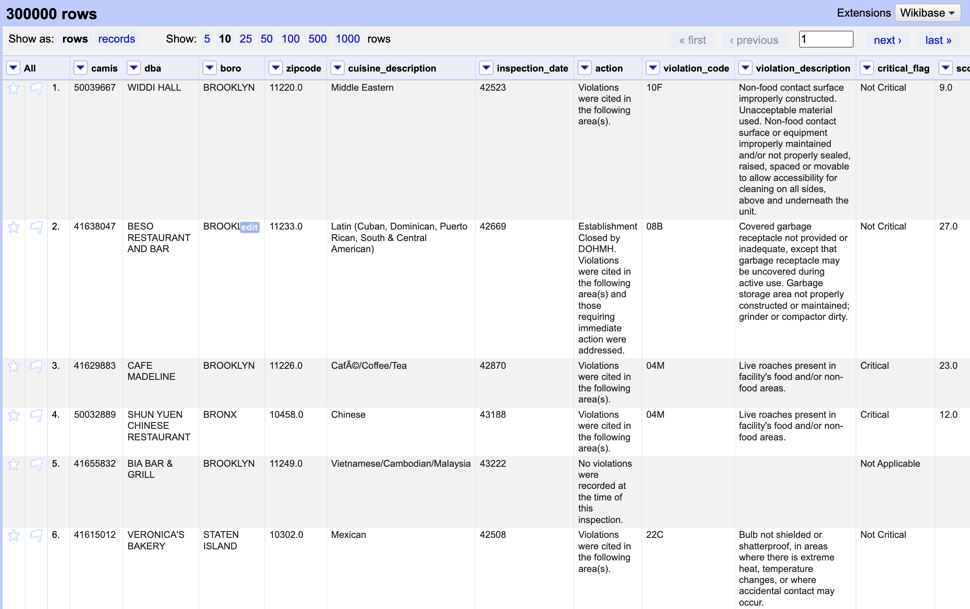
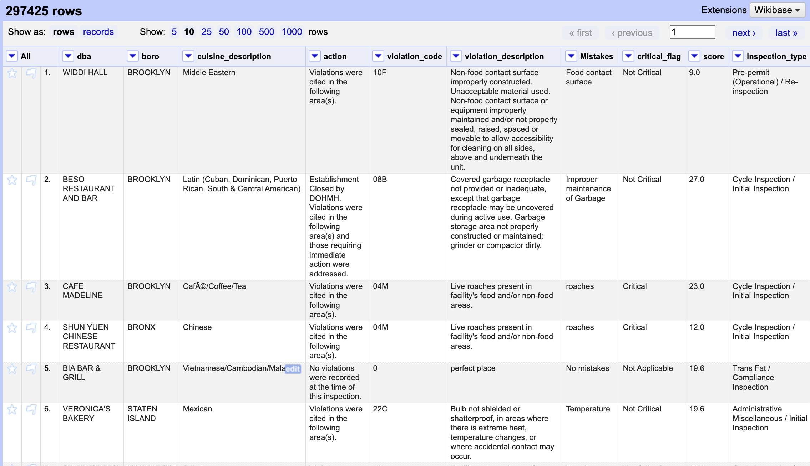
DATA PROCESSING

Slide 9
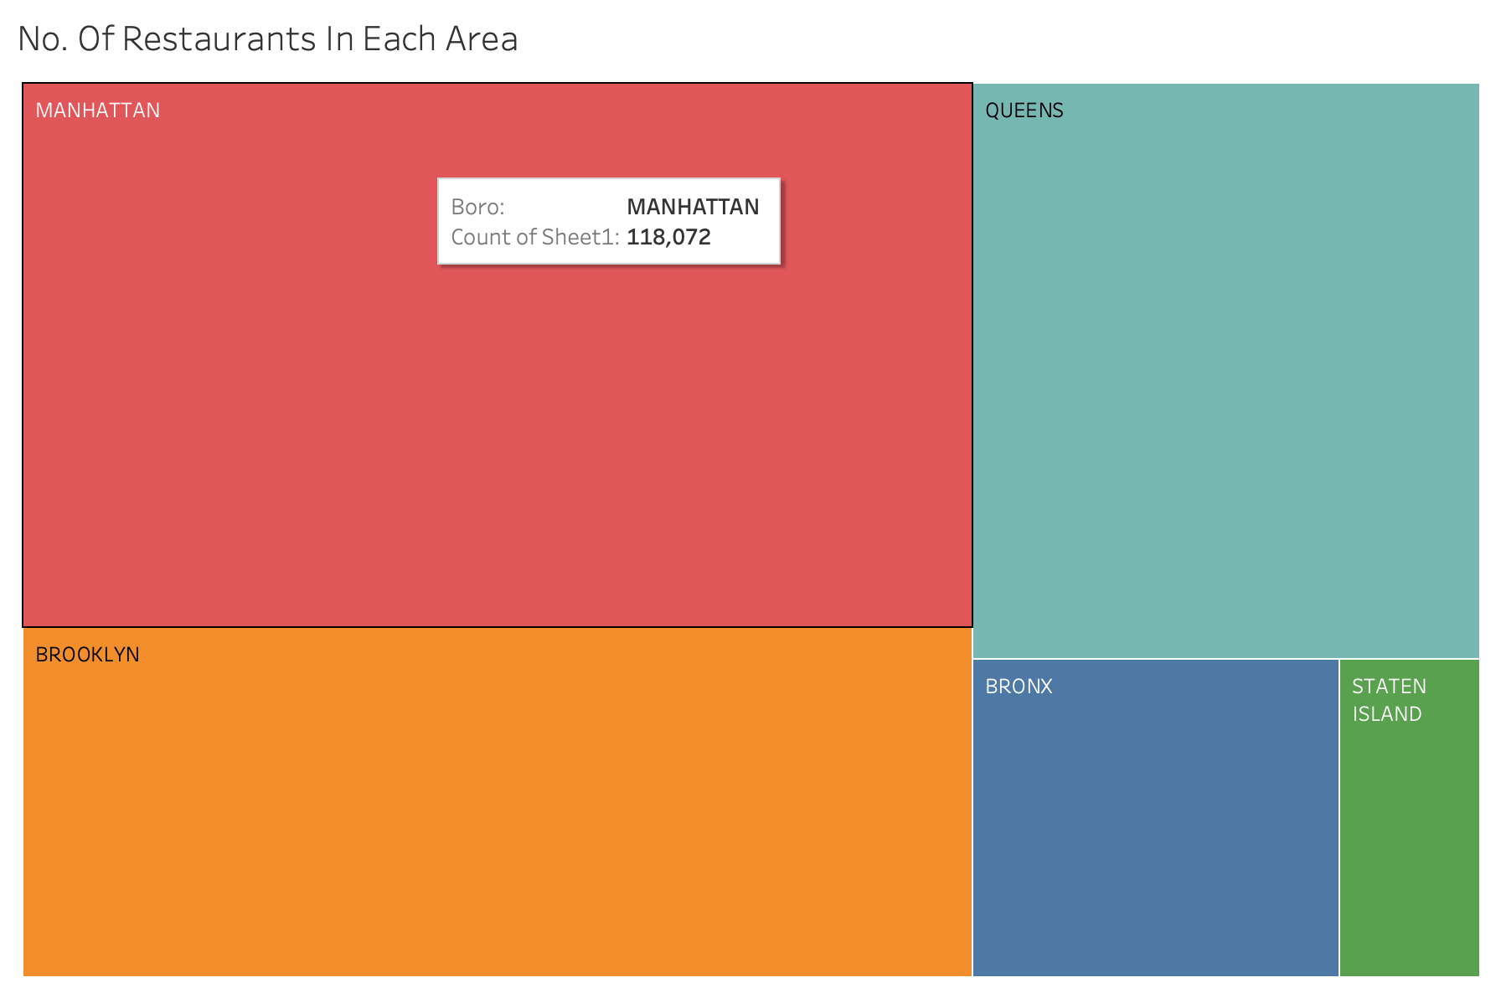
VISUALIZATIONS/INTERPRETATIONS
Number of Restaurants In Each Area

Slide 10
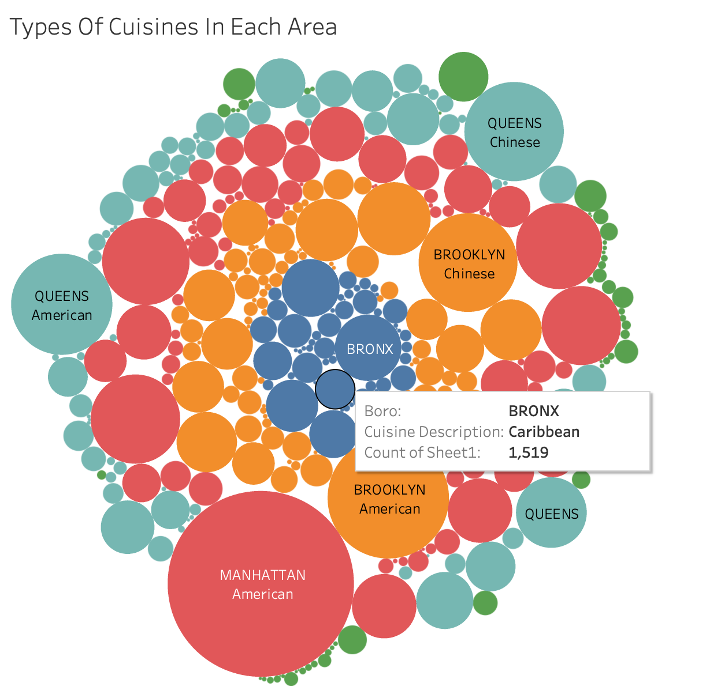
VISUALIZATIONS/INTERPRETATIONS
Count Of A Cuisine In Each Area

Slide 11
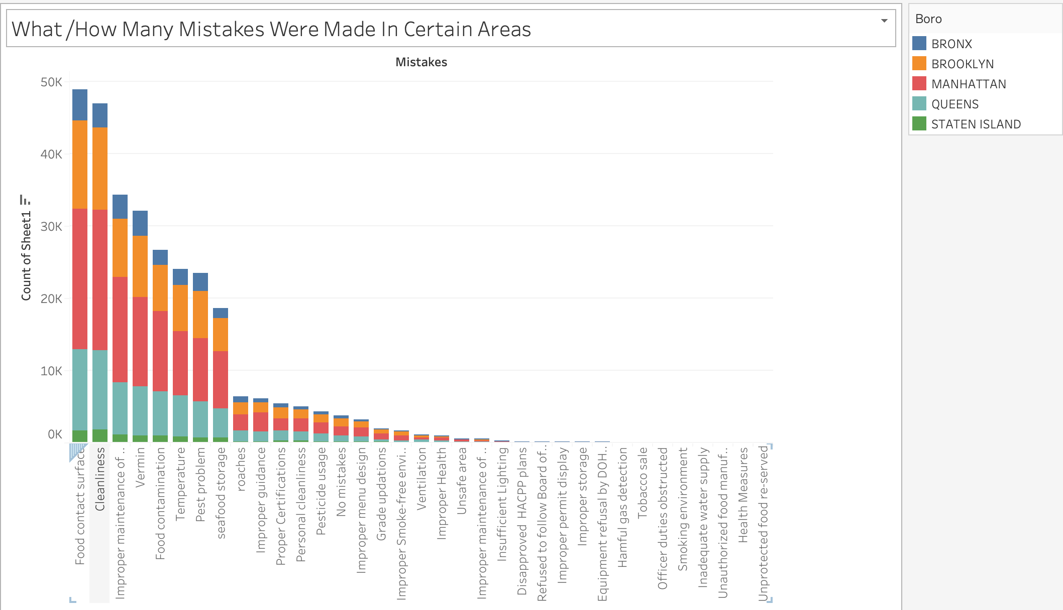
VISUALIZATIONS/INTERPRETATIONS
Type And Count Of A Violation / Mistake In Each Area

Slide 12
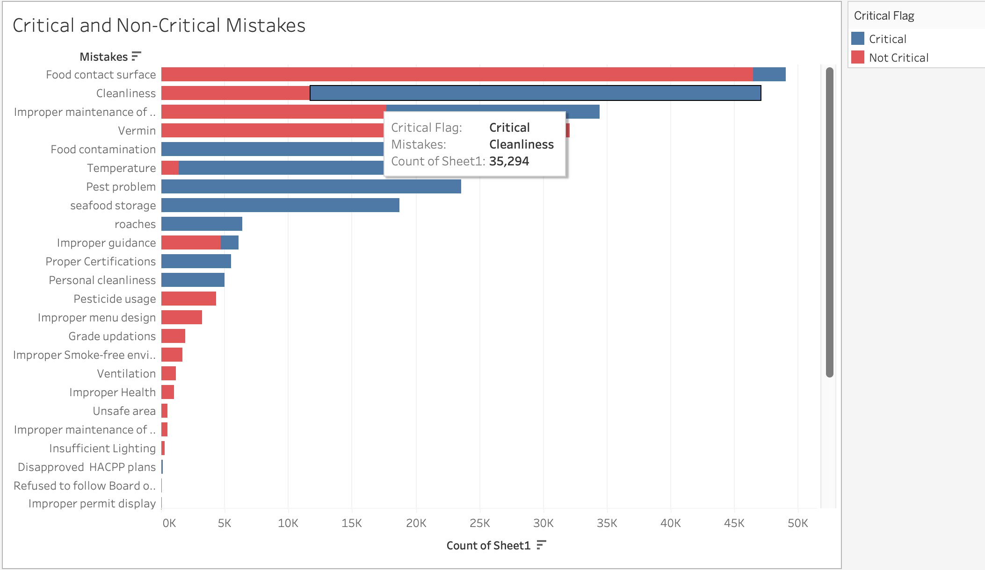
VISUALIZATIONS/INTERPRETATIONS
Number Of Critical And Non-Critical Mistakes

Slide 13
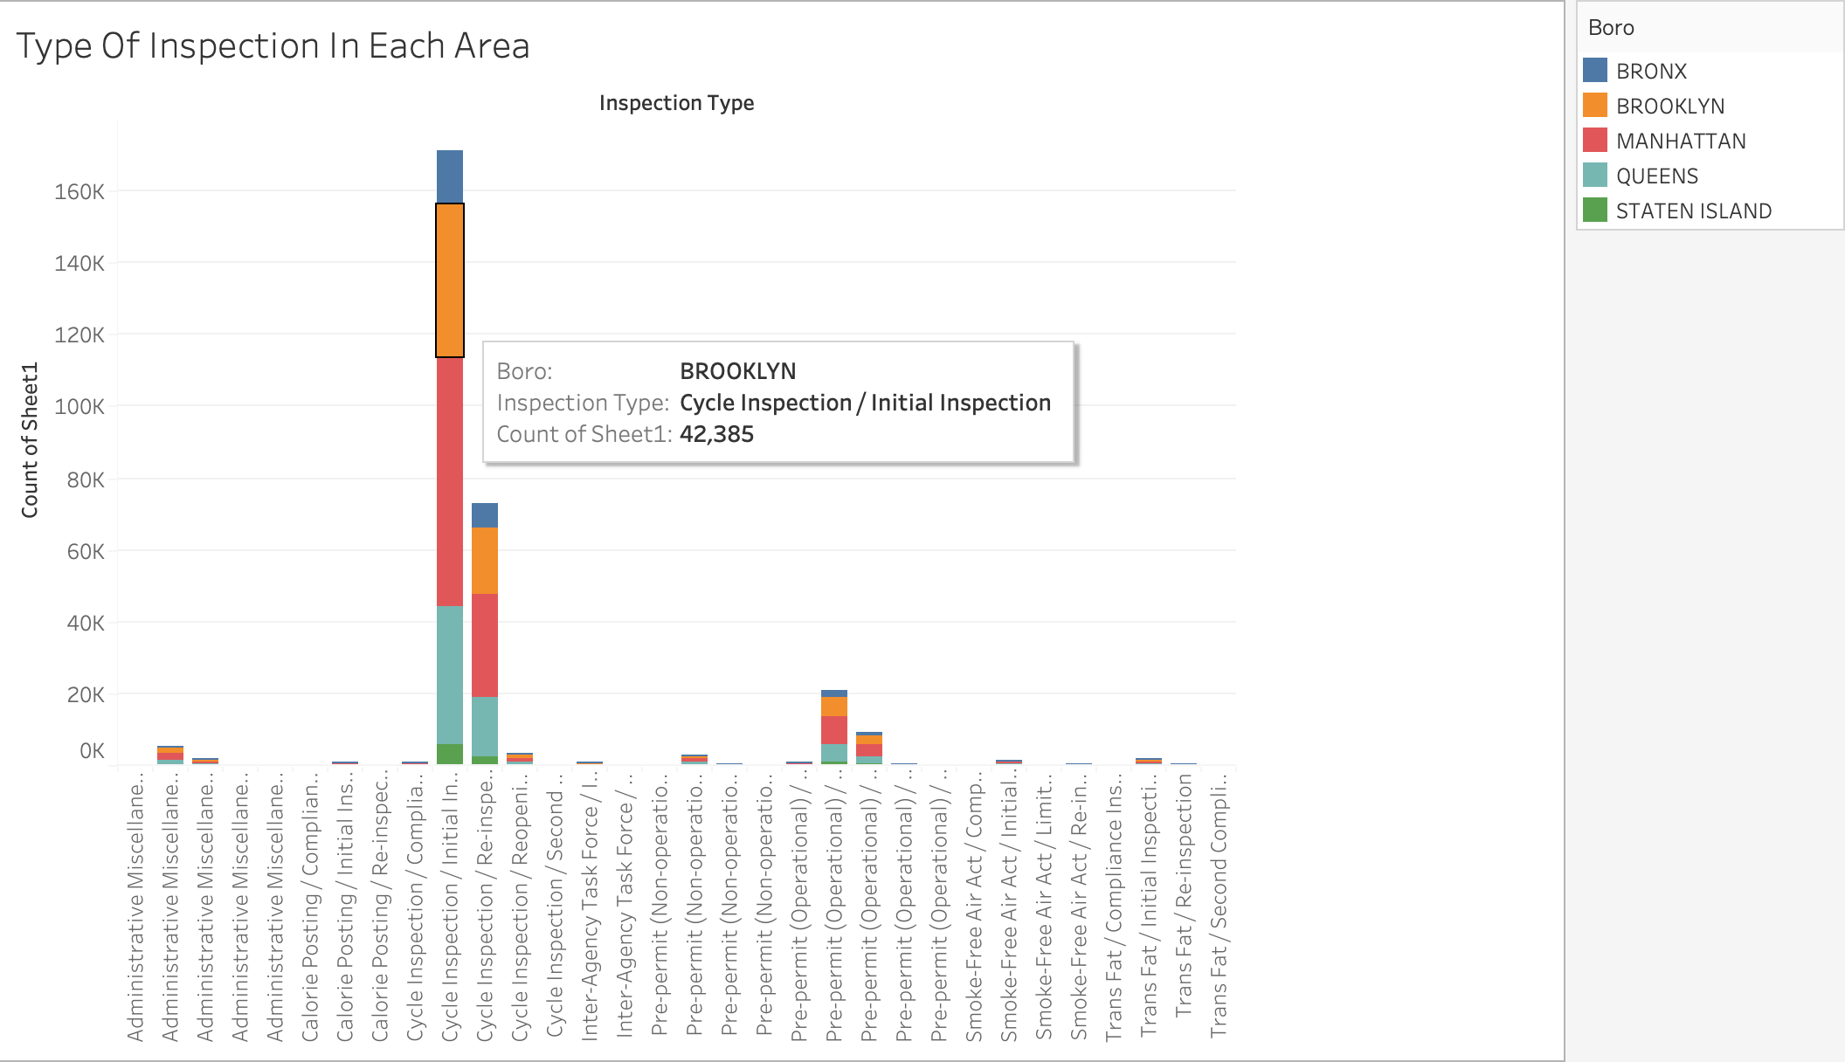
VISUALIZATIONS/INTERPRETATIONS
Type And Count Of Inspection In Each Area

Slide 14

VISUALIZATIONS/INTERPRETATIONS
Why do some boroughs report significantly more violations than others?
Why do some type of restaurants have more violations than others?
Why are there discrepancies in New York City Restaurant Inspection data?

Slide 15
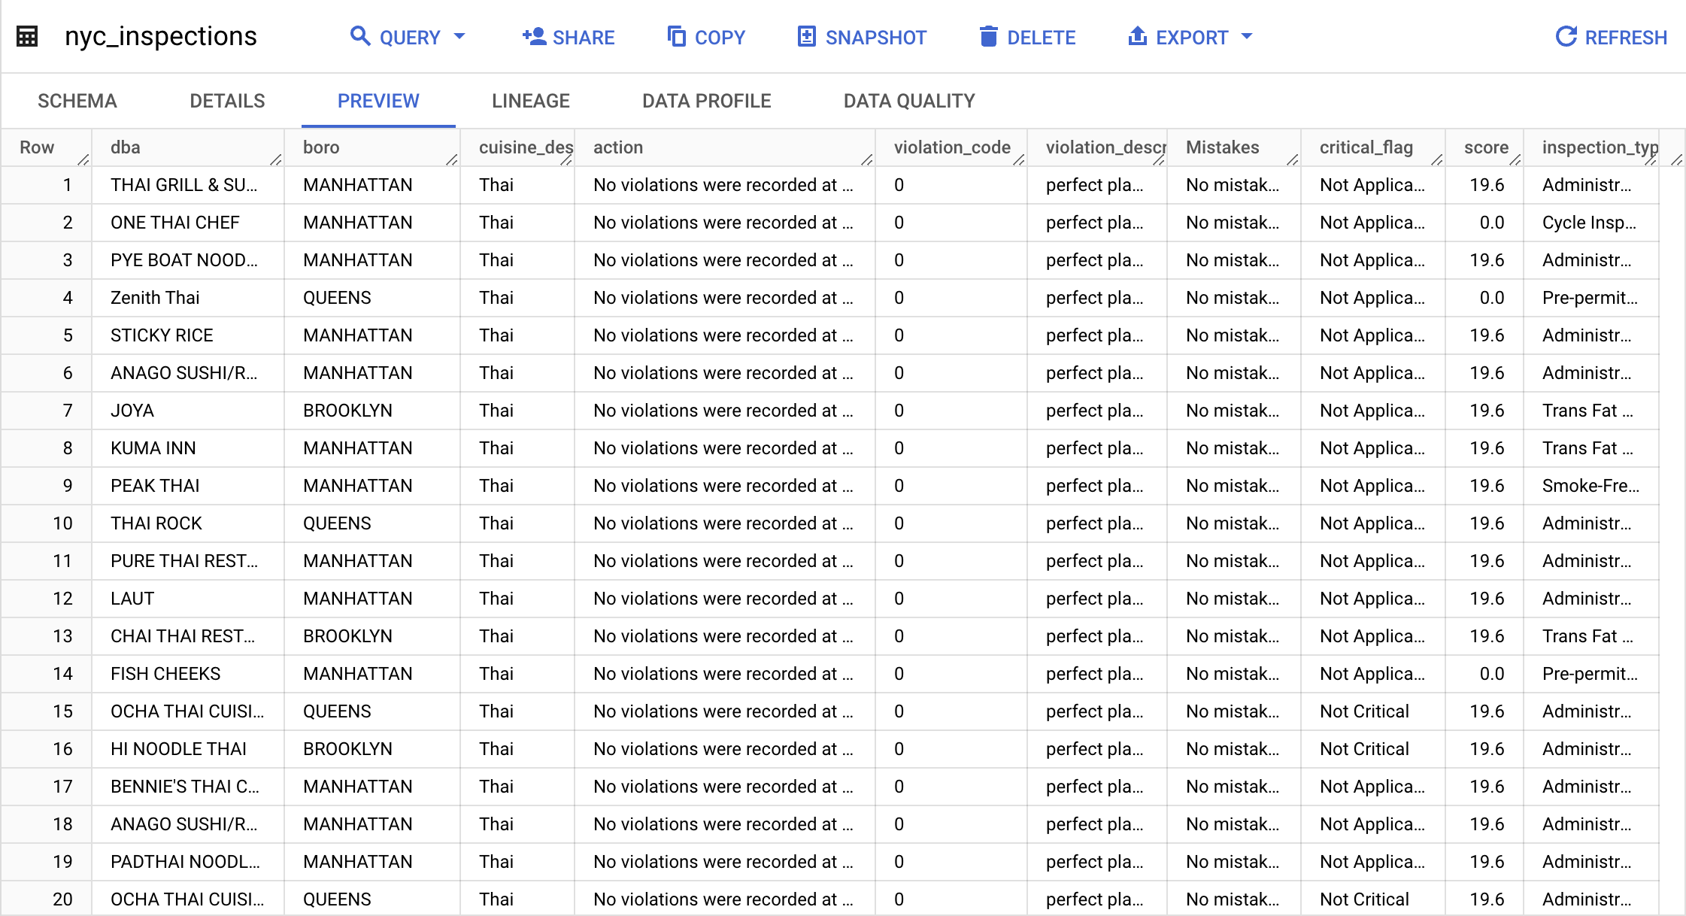
DATA STORAGE
GCP STORAGE
STRUCTURED DATA
BIGQUERY

Slide 16
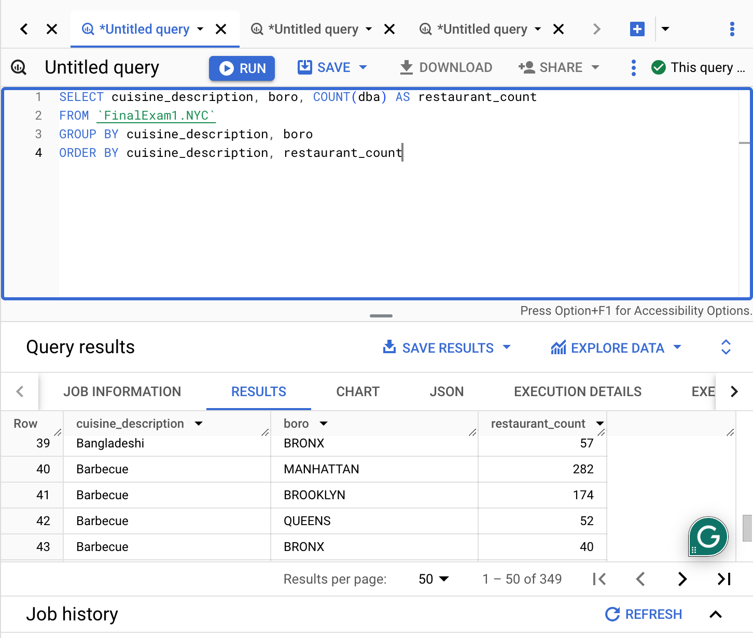
DATA ANALYSIS
Count Of Restaurants Offering Different Cuisines In Different Areas Of NYC

Slide 17
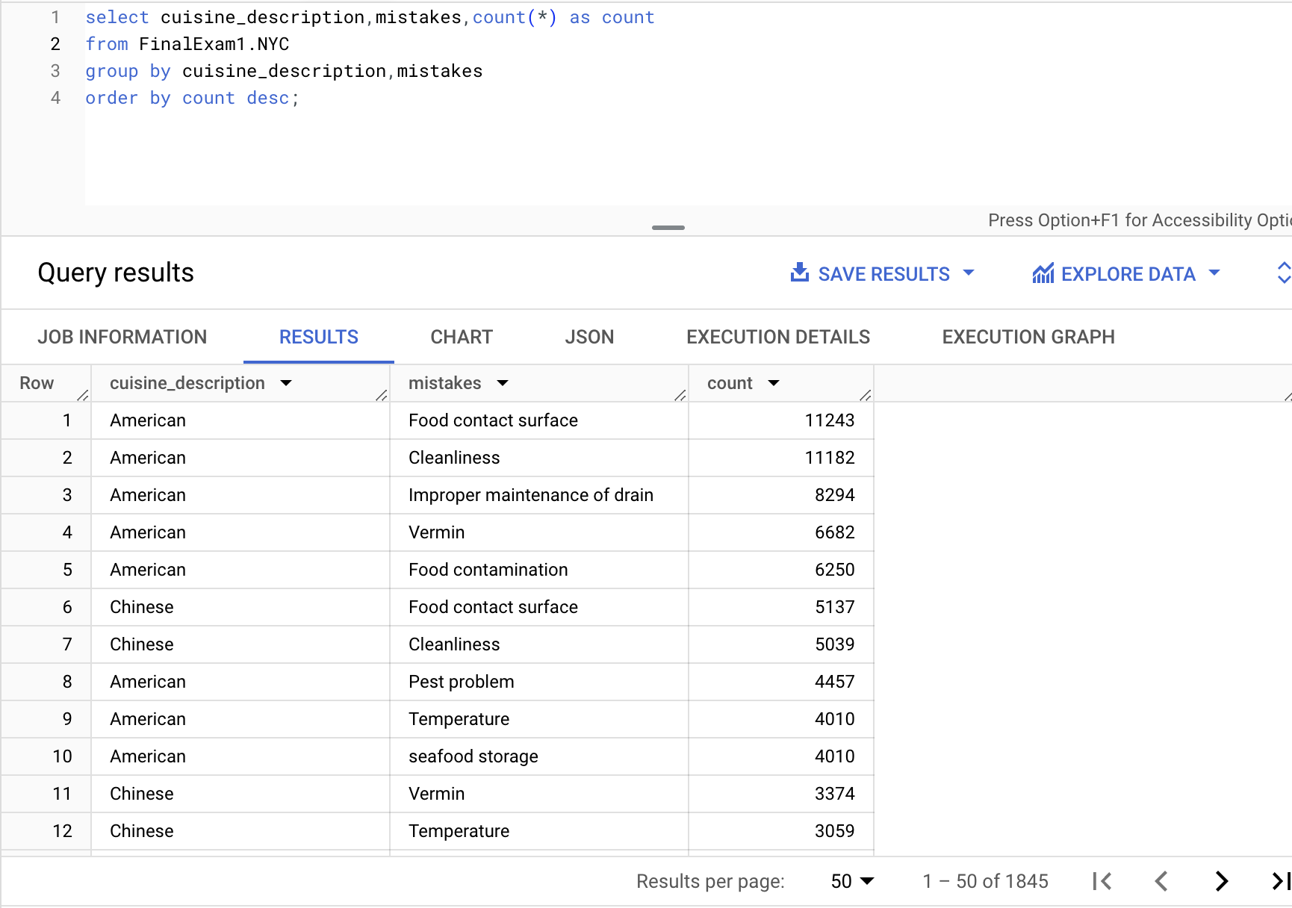
DATA ANALYSIS
Most Common Mistake With Each Particular Cuisine

Slide 18
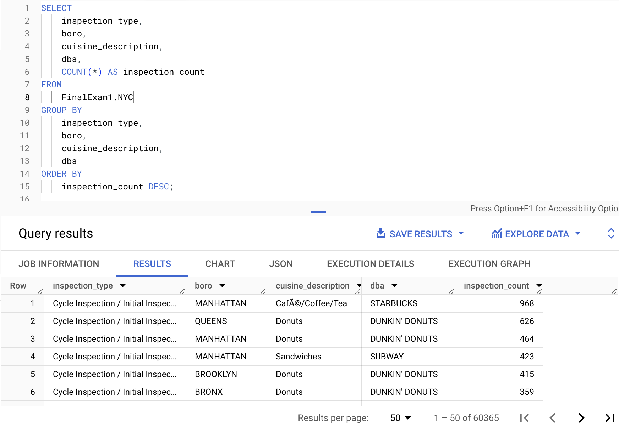
DATA ANALYSIS
Number Of Inspections On Restaurants Offering Different Cuisines In Different Areas

Slide 19

DATA ANALYSIS
What are the cuisines offered by restaurants in particular area and which areas are the most popular for what cuisine?
What is the most common mistake/ violation with each particular cuisine?
What type of Inspections are mostly conducted in different areas of NYC?

Slide 20


THANK YOU...

